Slide 1
Authentication
Client-server authentication using JWT

Slide 2
JWT - JSON Web Token
Yes, JWT is an acronym within an acronym (better than JSONWT)
Allows two parties to pass around information and guarantees that it has not been tampered with (digitally signed)
Not encrypted (although it could be)
The information in the token is called Claims
A claim of who the user is
A claim of what roles the user has
Others if your application needs them
Application uses Bearer Authentication
User who bears a valid token is authorized

Slide 3
The Process
The client requests authorization from an authorization server
In our case, our API is also our authorization server
Client passes credentials (encrypted, of course)
Server validates credentials; creates and returns a token (JWT)
Token contains user name; may contain roles and more
Client stores the token locally (browser local storage)
With every API request, client passes token in the headers
Authorization: Bearer <token>
With every API call, server verifies token and authorizes user
Verify signature is valid (not tampered)
Verify token has not expired

Slide 4
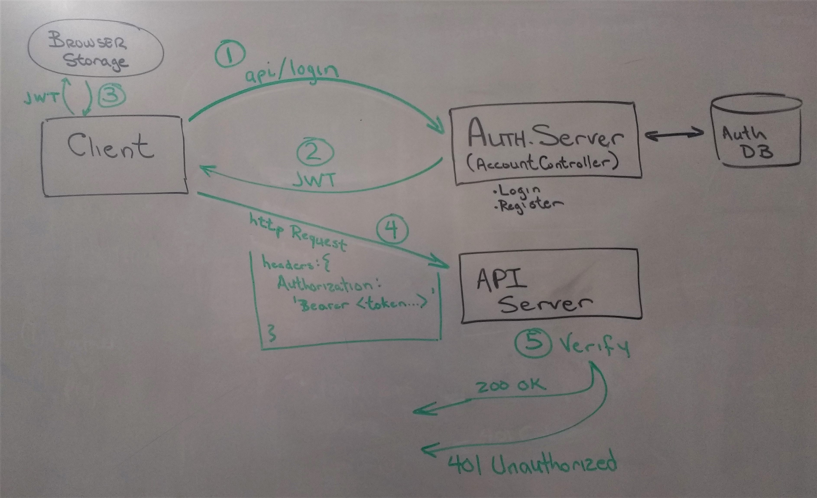
The Process (diagram)

Slide 5
Sample Project Setup
Setup the DB
[optional] Modify Schema.sql to create a users table in your application database
In SSMS, run Schema.sql
[optional] Run data.sql to add a default user (uid: user, pwd: greatwall)
Client (Vue project)
Open the file called ".env" at the root of the project
Modify the VUE_APP_REMOTE_API variable
Server (.NET project)
Change the default route for AccountController to [Route("api")]

Slide 6
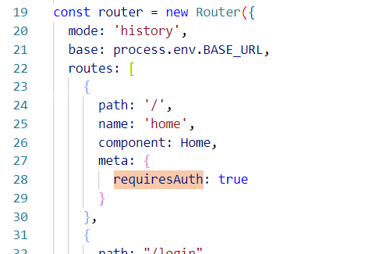
Protecting client routes
If a route requires user to be logged in
Use requiresAuth on the route meta object
User will be re-directed to the login page if not logged in

Slide 7
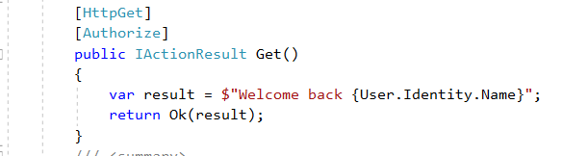
Protecting server methods
If a method requires the user to be logged in
Use the [Authorize] attribute on the method
You can also use it on the class
Use Roles parameter for specific roles
[Authorize(Roles="Admin")]
Comma-separate for multiple roles

